Slide 1
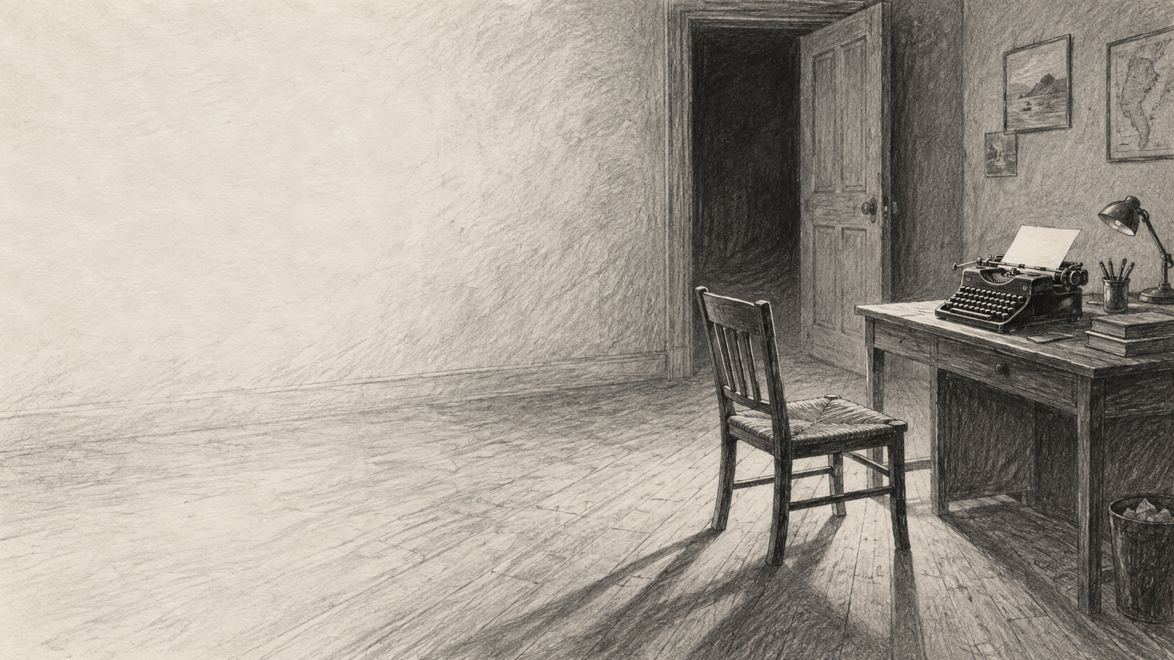
Quiet words.
Real fear.
Write a short scary story
with Hemingway-inspired prose.
Clear action. Concrete detail. Something unsaid.
01
Notes:
A brief writing lesson: about 12–15 minutes of teaching/practice, 10 minutes drafting, 3 minutes revision. These are selected craft habits inspired by Hemingway, not a formula that describes every sentence he wrote. All examples except the attributed quotation on slide 2 are original classroom writing. Motion plan only: use a 0.4-second Fade between slides, with manual advance. Native transitions and animations are not implemented by the available authoring API.
Artwork: AI-generated asset from the user’s AE Humanities ppts collection, 27-empty-writers-room-graphite.png.

Slide 2
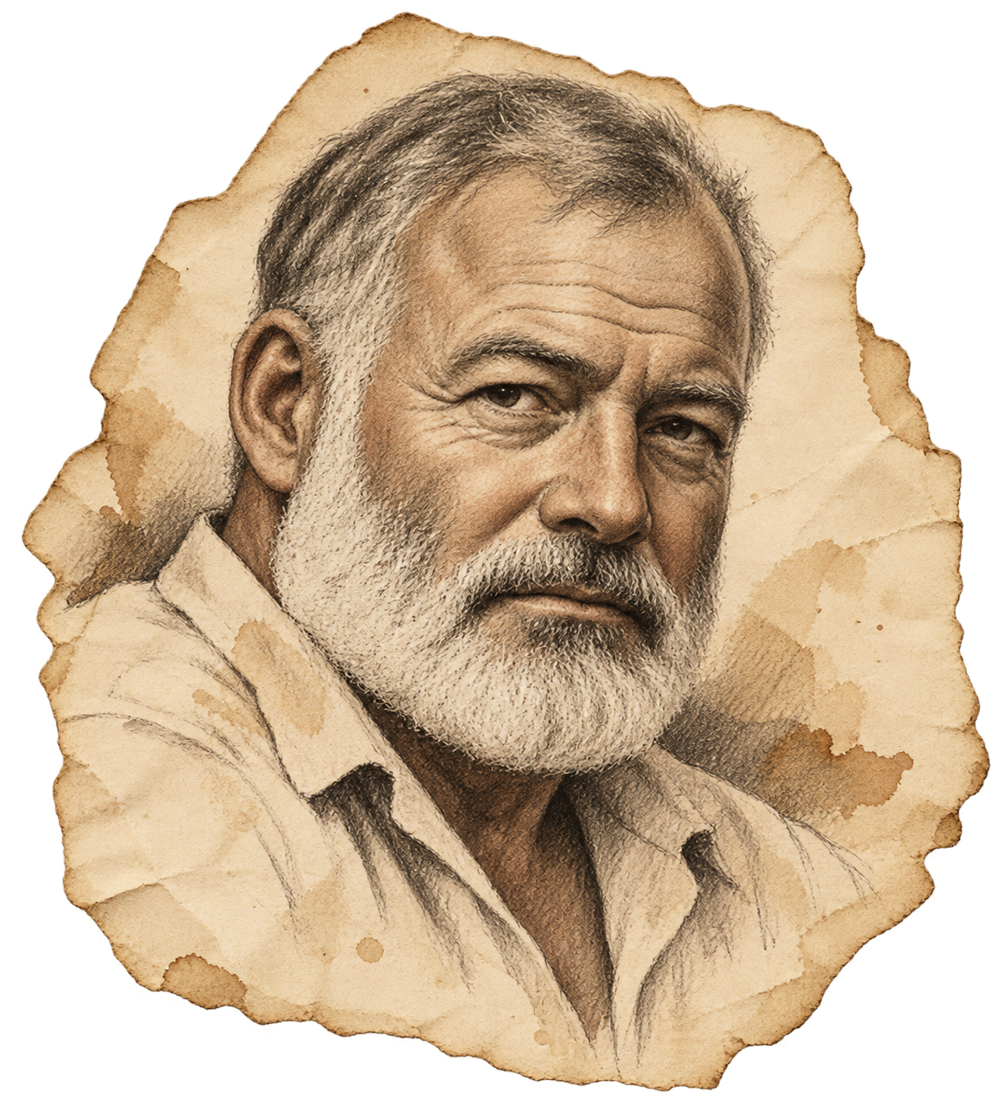
Look at Hemingway’s sentences
“There were pools of water in the courtyard. There were wet dead leaves on the paving of the courtyard. It rained hard.”
Ernest Hemingway · in our time (1924), chapter 6
Concrete things
Plain verbs
Varied rhythm
water · leaves · paving
were · rained
Two longer sentences,
then a short one.
02
Notes:
Source: Ernest Hemingway, in our time (Three Mountains Press, 1924), chapter 6. https://www.gutenberg.org/cache/epub/61085/pg61085-images.html The text actually displayed is the 1924 collection, not the expanded 1925 volume. The quotation comprises three consecutive sentences and 22 words. Context: a courtyard before an execution; the selected passage is non-graphic. Classroom interpretation: ordinary objects, repeated syntax and changing sentence length can make a scene concrete and controlled. Do not teach that Hemingway never used adjectives or long sentences. Ask which words the reader can picture.
Artwork: AI-generated asset from the user’s AE Humanities ppts collection, 21-hemingway-hand-drawn-portrait.png.

Slide 3
Start with someone doing something
WORDY DRAFT
Because she was very frightened, she began to walk slowly towards the old door.
She crept to the door.
She
crept
the door
Who?
What action?
What concrete thing?
03
Notes:
Original teaching examples. Ask students to find the action hidden inside the first sentence. “Crept” carries a slow, careful movement; the physical action lets the reader infer fear. This is a possible rewrite, not an exact synonym for every situation. An adjective can stay when it contributes useful information. Reveal plan: show the original first; click to reveal the rewrite, then the three sentence parts.

Slide 4

Let a detail carry the feeling
“He was terrified.”
“He missed the
keyhole twice.”
Choose one thing the reader can see or hear.
04
Notes:
Original examples. “He missed the keyhole twice” can imply fear, haste, cold or another cause. In a scary scene the surrounding clues guide the inference. Ask what “twice” contributes. Adjectives are not forbidden: keep precise details such as “wet” when they do work. Reveal plan: leave the prompt visible, then reveal model-response after students suggest a physical action.
Artwork: AI-generated asset from the user’s AE Humanities ppts collection, 10-brass-key-ribbon.png.

Slide 5
Give the reader a clue, not an explanation
ON THE PAGE
The spare key was on the table.
It was wet.
BENEATH THE SURFACE
The reader may suspect
that someone has come in.
Know what happened. Leave a fair clue.
05
Notes:
Hemingway described omission through his iceberg principle: the writer knows more than is stated. Source: George Plimpton’s interview with Ernest Hemingway, The Paris Review, Spring 1958, “The Art of Fiction No. 21”: https://www.theparisreview.org/interviews/4825/the-art-of-fiction-no-21-ernest-hemingway . The omission passage was checked in this full-text reproduction: https://bradybouchard.ca/republished/hemingway.html . Classroom application: make the visible events clear while leaving some cause, history or feeling unstated. Omission is not confusion. The example is original, and “someone came in” is a possible inference, not the only logical explanation. Reveal plan: the visible facts appear first; reveal the inference after pairs discuss it.

Slide 6
Let the rhythm change
I crossed the room and put my ear to the door.
The breathing stopped.
Carry the action forward. Then stop on the detail that matters.
06
Notes:
Original example. Read aloud first with one breath and then with a pause before the final sentence. The longer sentence follows the character’s movement; the shorter one stops that movement and focuses attention. Simple prose does not mean every sentence has the same length. “And” can join related actions.

Slide 7
A miniature story: The second cup
ORIGINAL CLASSROOM MODEL
I woke when the kitchen chair scraped the floor. My father used to sit there when he could not sleep. He had been dead a year.
I went down without turning on the lights. Two cups stood on the table. Steam rose from one.
I took the other cup to the sink. My hand shook, and the spoon struck the cup. Behind me, the chair scraped again.
I left the cup where he could reach it.
Which detail makes this unsettling? What feeling stays unspoken?
07
Notes:
Original classroom model written for this lesson; not a Hemingway quotation. Ask students to find (1) two concrete details, (2) the strongest action, and (3) something the narrator does not explain. Possible answers: scraped chair, steam, spoon striking the cup; leaving the cup within reach; whether the father has returned, whether the narrator is grieving, and why the narrator makes space for him. The last act adds longing to fear. This model is shorter than the independent writing task to keep close reading brief.

Slide 8

Your turn: make the fear visible
“I was extremely afraid when I suddenly realized that there was something very strange and frightening behind the bedroom door.”
Rewrite this as two clear sentences.
Use an action and a sound or object.
08
Notes:
60–90 seconds. Pair practice before the independent story. Many answers are possible. One original model: “The handle turned. I held my breath.” Students can add a meaningful concrete detail, for example “The handle turned from the other side.” Do not require this wording or penalize a different effective image. The answer stays in the notes so it does not spoil the task. Motion plan only: use a 0.4-second Fade between slides, with manual advance. Native transitions and animations are not implemented by the available authoring API. Suggested optional reveal: put the sample answer in a separate text box and apply Appear on click.
Artwork: AI-generated asset from the user’s AE Humanities ppts collection, 50-library-text-center.png.

Slide 9
Plan four small changes
01
02
03
04
→
→
→
An ordinary moment
A detail is wrong
A small choice
A final clue
A simple, everyday
action.
A familiar thing
changes.
The character
decides what to do.
One detail leaves
us uneasy.
What does your character want badly enough to stay?
09
Notes:
This is a scaffold for this exercise, not a universal story formula. Students may change its order. Give 1–2 minutes for planning. Ask them to decide privately what is happening, even if the final story leaves its cause open. Meaningful sentences should reveal a character, move the action or sharpen the threat. A loud twist is optional.

Slide 10
Write your story
100–150
One place; one or two characters.
WORDS · 10 MINUTES
Clear actions and two concrete details.
Optional opening:
“At midnight, someone
used my key.”
A short sentence placed for effect.
A final clue you leave unexplained.
10
Notes:
Suggested classroom exercise, not a change to the earlier 500-word article-review assignment. Give 10 minutes for 100–150 words; shorten or extend the time for the class. Use the opening only if it helps. These are learning goals, not a ban on all adjectives, dialogue or longer sentences. No graphic violence is needed; uncertainty, sound, ordinary objects and human attachment can carry the tension.

Slide 11
Read it aloud. Cut what adds nothing.
ACTION
Underline your verbs. Can the reader follow what happens?
DETAIL
Circle the one detail that carries the most feeling.
CUT
Remove repeated emotion labels and empty words.
ENDING
Try deleting the final explanation. Is the story stronger?
Partner: “The detail that unsettled me most was ___ because ___.”
11
Notes:
3-minute revision. A complete short sentence has a subject and verb. Students may use longer sentences if the meaning is clear; do not force a whole story into fragments. Partner response should name the particular detail that creates fear and ask a useful question about unclear action. Do not ask the writer to explain every mystery. Source and image credits are attached to the relevant slides. Motion plan only: use a 0.4-second Fade between slides, with manual advance. Native transitions and animations are not implemented by the available authoring API.

